Slide 1
Chapter 13
SUPERVISED LEARNING:
NEURAL NETWORKS
Cios / Pedrycz / Swiniarski / Kurgan

Slide 2
Outline
Introduction
Biological Neurons and their Models
  Spiking
  Simple neuron
Learning Rules
  for spiking neurons
  for simple neurons
Radial Basis Functions
  …
  Confidence Measures
  RBFs in Knowledge Discovery
© 2007 Cios / Pedrycz / Swiniarski / Kurgan

Slide 3
Introduction
Interest in artificial neural networks (NN) arose from the realization that the human brain still is, and for a long time will be, the best recognition device.
NNs are universal approximators, namely, they can approximate any mapping function between known inputs and corresponding known outputs (training data),
to any desired degree of accuracy
(meaning the error of approximation can be made arbitrarily small).
© 2007 Cios / Pedrycz / Swiniarski / Kurgan

Slide 4
Introduction
  NN characteristics:
      learning and generalization ability
      fault tolerance
      self-organization
      robustness
      generally, simple basic calculations
© 2007 Cios / Pedrycz / Swiniarski / Kurgan

Slide 5
Introduction
  Typical NNs application areas:
        clustering (SOM)
        prediction
        function approximation
        pattern recognition
© 2007 Cios / Pedrycz / Swiniarski / Kurgan

Slide 6
Introduction
When to use NN?
Problem requires quantitative knowledge from data.
Data are available but often are multivariable, noisy, error-prone.
The phenomena involved are so complex that other approaches are not feasible or computationally viable.
Project development time is short (but with enough time for training).
© 2007 Cios / Pedrycz / Swiniarski / Kurgan

Slide 7
Introduction
“Black-box” nature of neural networks.
Learning aspects:
  overfitting
  learning time
  learning schemes
  scaling up properties
© 2007 Cios / Pedrycz / Swiniarski / Kurgan

Slide 8
Introduction
To design any type of NN the following key elements must be determined:
the neuron model(s) used for computations
a learning rule, used to update the weights/synapses associated with connections between the neurons in a network
the topology of a network, which determines how the neurons are arranged and interconnected
© 2007 Cios / Pedrycz / Swiniarski / Kurgan

Slide 9
Biological Neurons and their Models
All neuron models (in short called neurons or nodes) resemble biological neurons to some extent.
The degree of this resemblance is an important distinguishing factor between different neuron models.
© 2007 Cios / Pedrycz / Swiniarski / Kurgan

Slide 10
Brief History of Neuron Models
and Learning Rules
1943: McCulloch-Pitts model of a neuron
1948: Konorski’s / 1949 Hebb’s learning rule
1958: Perceptron (F. Rosenblatt) pattern recognition system (classifier)
1960: Widrow-Hoff’s Adaline and Madaline
1951: Multilayer neural networks and backpropagation rule, Robins and Monro, 1951; Werbos, 1974; Rumelhart, Hinton, Williams, 1986
1982: Kohonen’s Winner-Takes-All rule
2004: Spike Time-Dependent Plasticity (STDP) rule of Song and Abbot
2006: Synaptic Activity Plasticity Rule (SAPR) of Swiercz, Cios, Staley et al.
© 2007 Cios / Pedrycz / Swiniarski / Kurgan

Slide 11
Biological Neurons and their Models
The cost of high neuron model accuracy is high complexity and thus networks comprised of such neurons usually do not exceed a few thousand neurons.
An example of a biologically accurate model is the Hodgkin-Huxley neuron model.
Other models, like the integrate-and-fire model, are less complex but more loosely biologically correct.
© 2007 Cios / Pedrycz / Swiniarski / Kurgan

Slide 12
Biological Neurons and their Models
McCulloch-Pitts model, the first very simple model of a biological neuron preserves only a couple of features of a biological neuron:
after receiving the inputs it sums them up, and
if the sum is above its threshold it “fires” / generates a single output.
Because of its simplicity, networks built of such neurons can be large.
© 2007 Cios / Pedrycz / Swiniarski / Kurgan

Slide 13
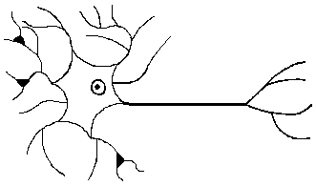
Biological Neurons and their Models
© 2007 Cios / Pedrycz / Swiniarski / Kurgan

Slide 14
Biological Neurons and their Models
Integrate-and-fire models
They provide simplification of spike generation while accounting for the changes in membrane potential and other essential neuron properties.
MacGregor’s model closely models the neuron’s behavior in terms of membrane potential, potassium channel response, refractory properties, and adaptation to stimuli.
Instead of modeling each individual ion channel (except for potassium) it imitates the resulting neuron’s excitatory and inhibitory properties.
© 2007 Cios / Pedrycz / Swiniarski / Kurgan

Slide 15
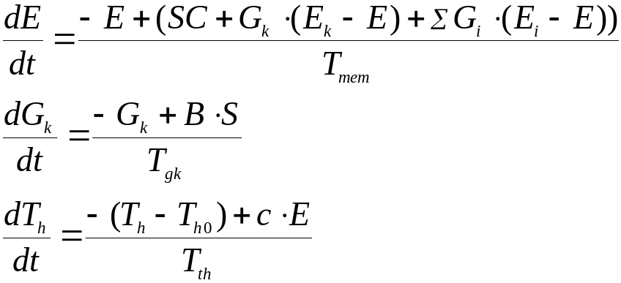
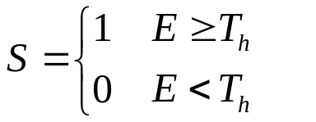
Integrate-and-fire Model
Transmembrane potential E :
Refractory properties:
Accomodation of the treshold T_{h}:
E – transmembrane potential
T_{h} – time-varying threshold
G_{k} – potassium conductance
SC – synaptic current input
E_{k} – membrane resting potential
G_{s} – synaptic conductances
S – 1 when neuron fires
0 otherwise
E_{i} – synaptic resting potentials
T_{mem} – membrane time constant
T_{h0} – resting value of threshold
c∈[0,1] – determines the rise of threshold
T_{th} – time constant of decay threshold
B – determines the amount of the post firing potassium increment
T_{gk} – time constant of decay of G_{k}
© 2007 Cios / Pedrycz / Swiniarski / Kurgan

Slide 16
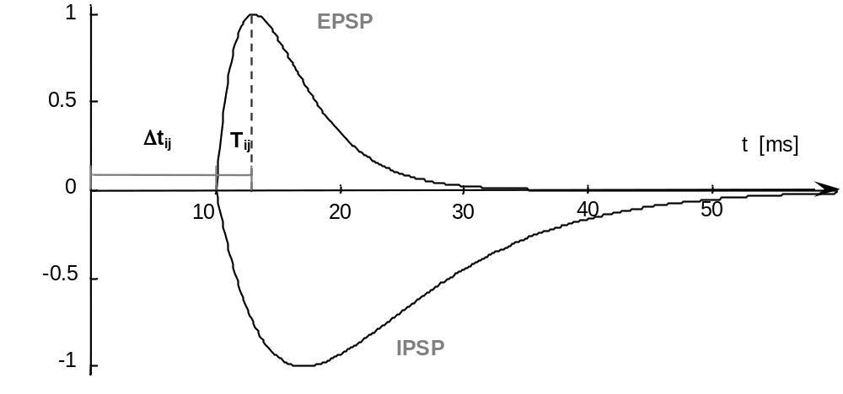
Biological Neurons and their Models
EPSP and IPSPF:
© 2007 Cios / Pedrycz / Swiniarski / Kurgan

Slide 17
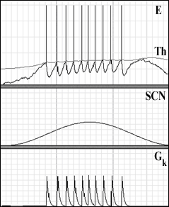
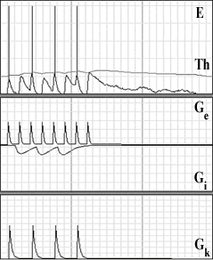
Biological Neurons and their Models
Neuron membrane potential E responses for stimulation with external current SCN (left), and with excitatory G_{e} and inhibitory G_{i} spikes (right). G_{k} is K⁺ channel response.
© 2007 Cios / Pedrycz / Swiniarski / Kurgan

Slide 18
Biological Neurons and their Models
Integrate-and-fire model
If the stimulus is strong enough for the membrane potential to reach the threshold, the neuron fires (generates a spike train traveling along the axon).
For a short time, immediately after the spike generation, the neuron is incapable of responding to any additional stimulation. This time interval is referred to as the absolute refractory period. Following the absolute refractory period is an interval known as the relative refractory period.
© 2007 Cios / Pedrycz / Swiniarski / Kurgan

Slide 19
Biological Neurons and their Models
Very Simple Spiking Neuron model
The VSSN model of a spiking neuron does not require solving any differential equations but it retains key functions of biological neurons:
that the neurons can form multiple time-delayed connections with varying strengths to other neurons,
that communication between the neurons occurs by slowly decaying intensity pulses, which are transmitted to connecting neurons,
that the firing rate is proportional to the input intensity, and
that firing occurs only when the input intensity is above a firing threshold.
© 2007 Cios / Pedrycz / Swiniarski / Kurgan

Slide 20
Biological Neurons and their Models
Very Simple Spiking Neuron model
The VSSN model is described by a set of equations broken down into
input
internal operation and
output.
© 2007 Cios / Pedrycz / Swiniarski / Kurgan

Slide 21
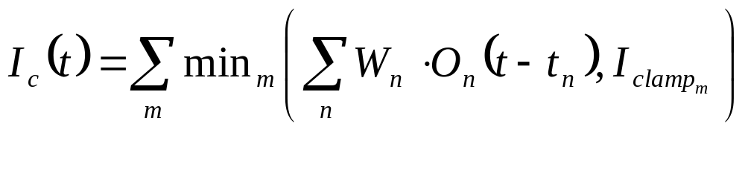
Biological Neurons and their Models
Very Simple Spiking Neuron model
© 2007 Cios / Pedrycz / Swiniarski / Kurgan

Slide 22
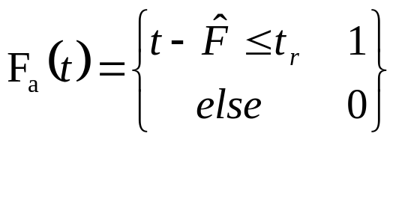
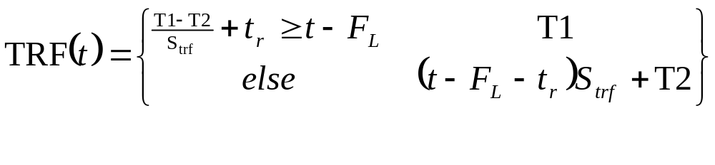
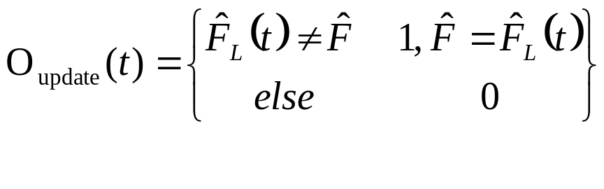
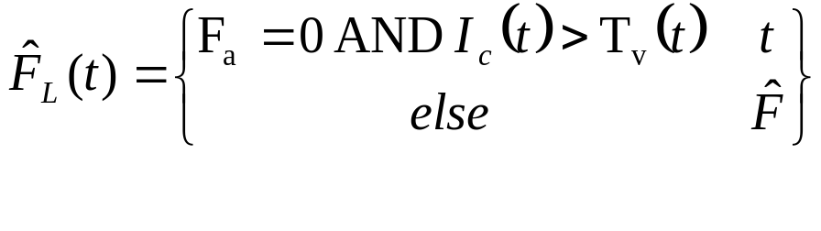
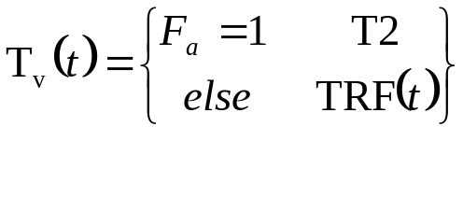
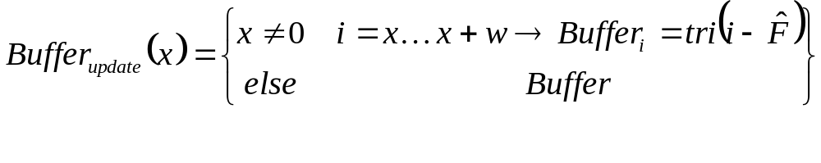
Biological Neurons and their Models
Very Simple Spiking Neuron model
© 2007 Cios / Pedrycz / Swiniarski / Kurgan

Slide 23
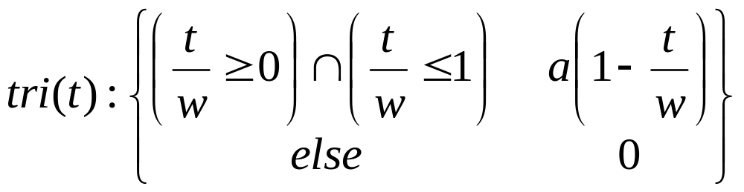
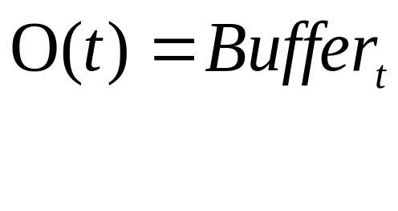
Biological Neurons and their Models
Very Simple Spiking Neuron model
© 2007 Cios / Pedrycz / Swiniarski / Kurgan

Slide 24
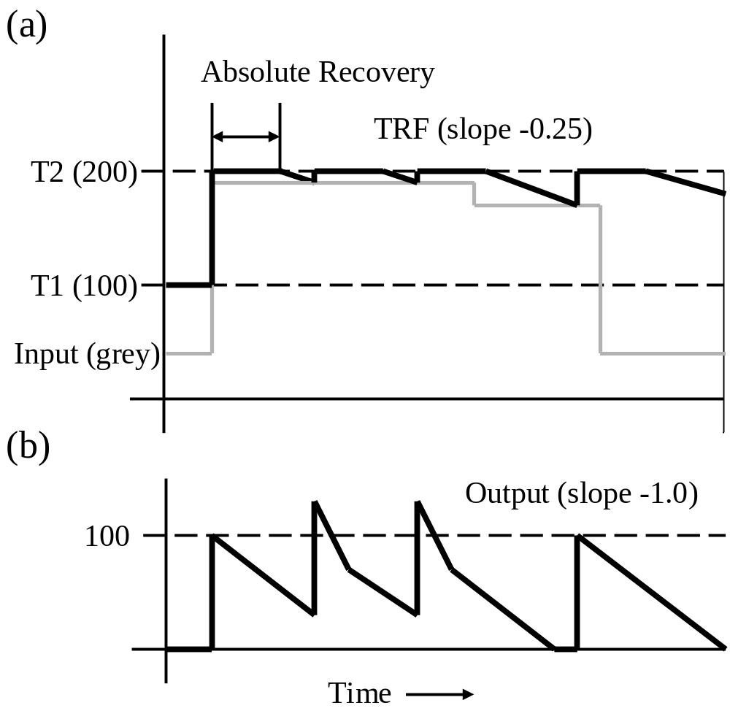
Biological Neurons and their Models
Very Simple Spiking Neuron model
© 2007 Cios / Pedrycz / Swiniarski / Kurgan

Slide 25
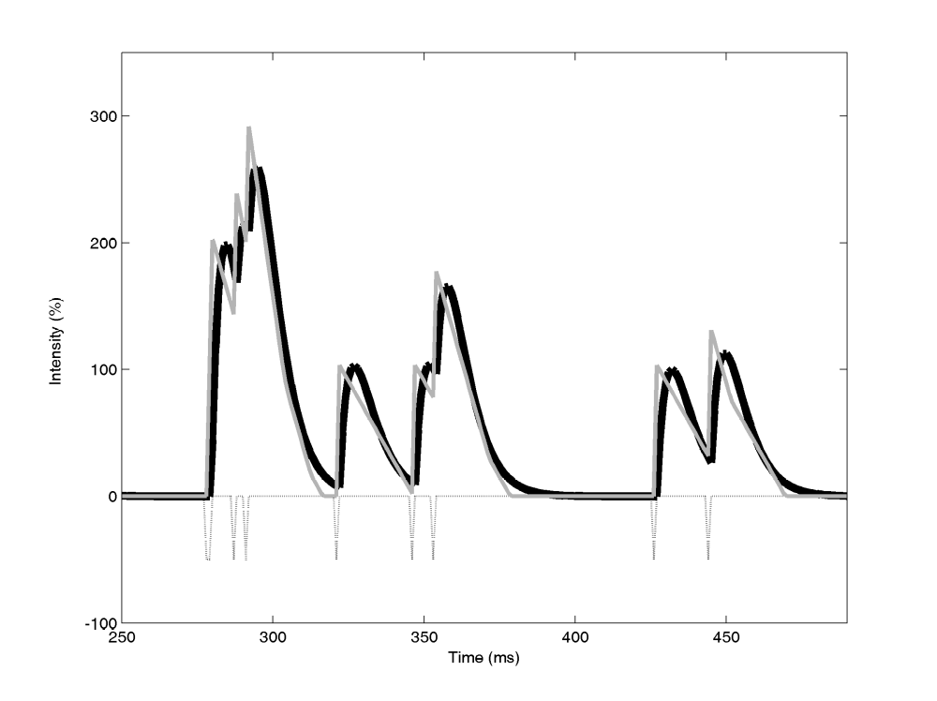
Biological Neurons and their Models
Very Simple Spiking Neuron model
© 2007 Cios / Pedrycz / Swiniarski / Kurgan

Slide 26
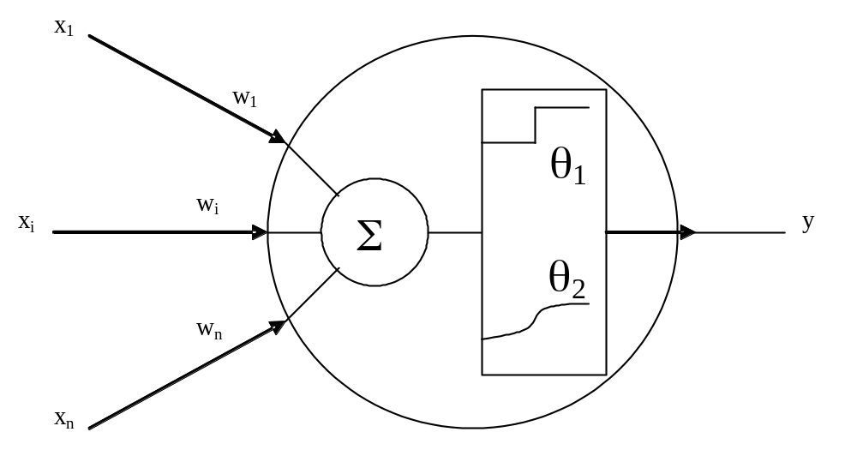
Simple Neuron Model
© 2007 Cios / Pedrycz / Swiniarski / Kurgan

Slide 27
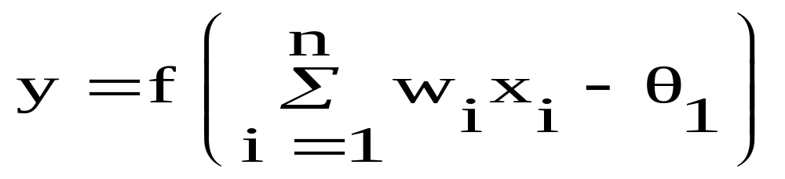
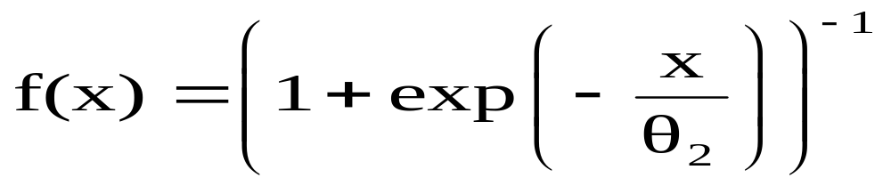
Simple Neuron Model
© 2007 Cios / Pedrycz / Swiniarski / Kurgan

Slide 28
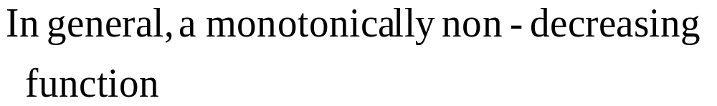
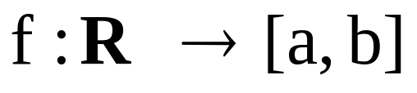
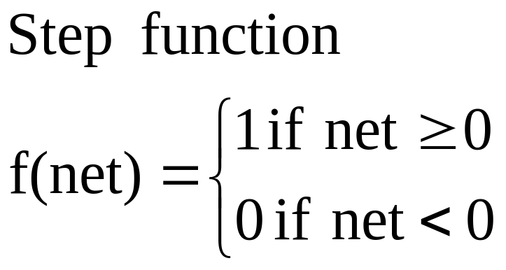
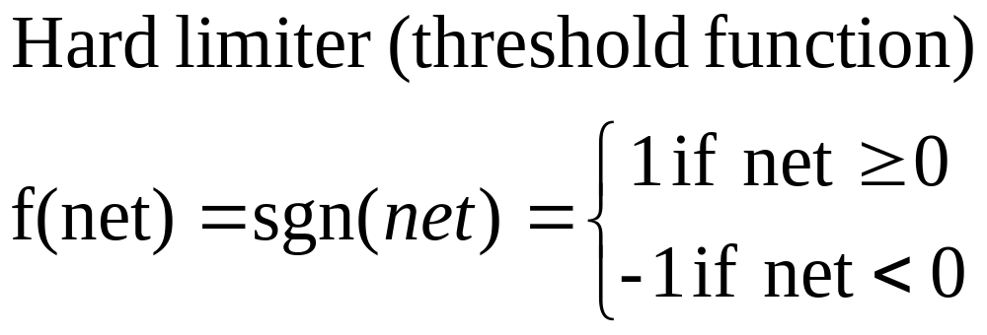
Types of Activation Functions
© 2007 Cios / Pedrycz / Swiniarski / Kurgan

Slide 29
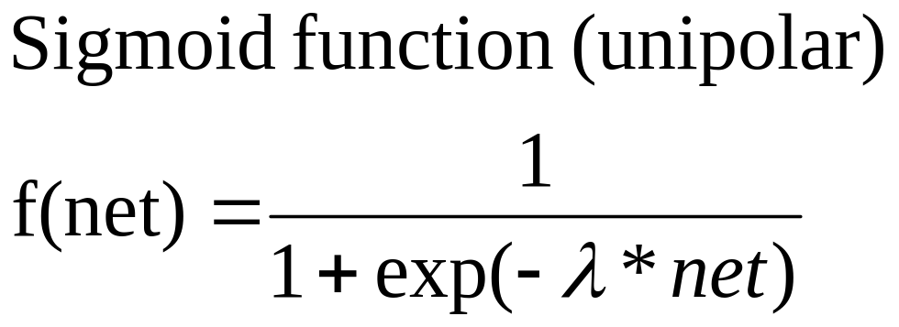
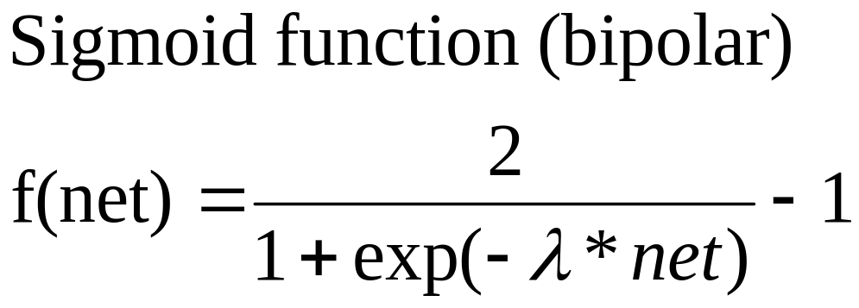
Types of Activation Functions
© 2007 Cios / Pedrycz / Swiniarski / Kurgan

Slide 30
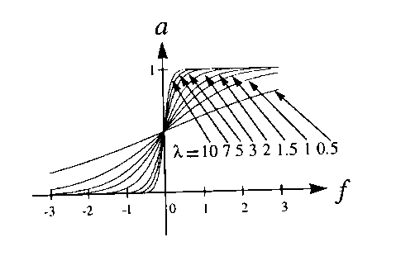
Sigmoid Activation Function
y
net
© 2007 Cios / Pedrycz / Swiniarski / Kurgan

Slide 31
Generalization Abilities
DATA
Training Set
Testing Set
An excessively large neural network
gives rise to the memorization effect
MEMORIZATION does NOT lead to GENERALIZATION
© 2007 Cios / Pedrycz / Swiniarski / Kurgan

Slide 32
Learning Rules
For spiking neurons:
All learning rules are based to some degree on Konorski’s / Hebb’s observation:
if a presynaptic neuron i repeatedly fires a postsynaptic neuron j, then the synaptic strength between the two is increased
© 2007 Cios / Pedrycz / Swiniarski / Kurgan

Slide 33
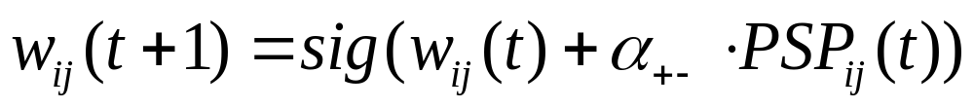
Learning Rules
For spiking neurons:
The adjustment of the strength of synaptic connections between neurons takes place every time the postsynaptic neuron fires.
The learning rate α controls the amount of adjustment; it can assume any value, with 0 meaning that there is no learning.
To keep the synaptic connection strength bounded, a sigmoid function is used to produce a smoothly shaped learning curve:
© 2007 Cios / Pedrycz / Swiniarski / Kurgan

Slide 34
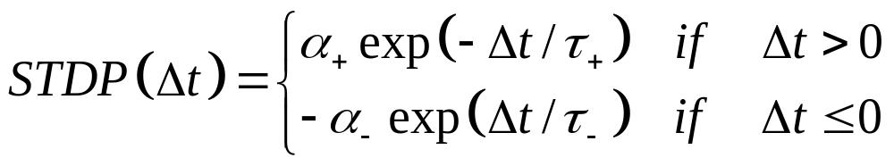
Learning Rules
For spiking neurons:
The Synaptic Time-Delayed Plasticity (STDP) rule is described by
© 2007 Cios / Pedrycz / Swiniarski / Kurgan

Slide 35
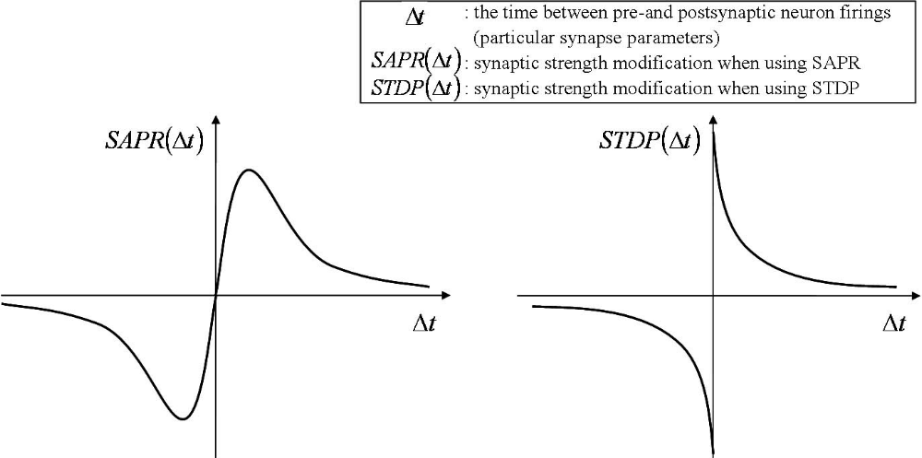
Learning Rules
For spiking neurons:
© 2007 Cios / Pedrycz / Swiniarski / Kurgan

Slide 36
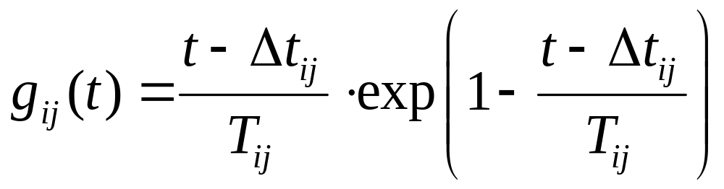
Learning Rules
For spiking neurons:
The PSP can be either excitatory (EPSP) or inhibitory (IPSP) and is proportional to the synaptic conductance change. These changes directly affect the neuron’s membrane potential. The synaptic conductance between neurons i and j is obtained from
© 2007 Cios / Pedrycz / Swiniarski / Kurgan

Slide 37
Learning Rules
For spiking neurons:
© 2007 Cios / Pedrycz / Swiniarski / Kurgan

Slide 38
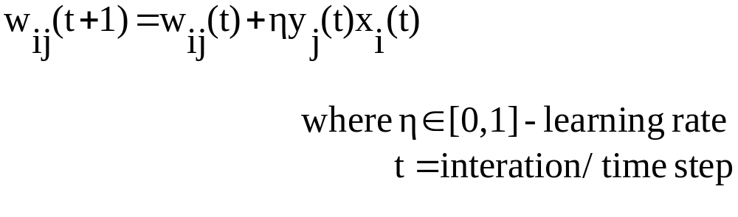
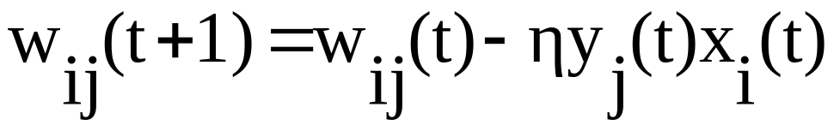
Learning Rules
If a presynaptic neuron i, repeatedly fires a postsynaptic neuron j, the synaptic strength between the two neurons is increased
Otherwise it is decreased
The resulting final weight vector points in the direction of the maximum variance of the data.
© 2007 Cios / Pedrycz / Swiniarski / Kurgan

Slide 39
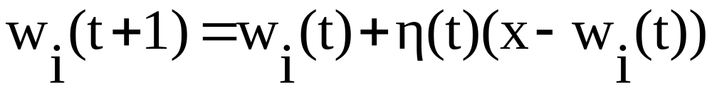
Learning Rules
Winner-Takes-All
Neurons compete for activation; only the winning neuron will fire and increase its weight
Weight vector moves closer to the input vector;
if training data is normalized and consists of several clusters then winning neuron weight vectors point towards cluster centers.
© 2007 Cios / Pedrycz / Swiniarski / Kurgan

Slide 40
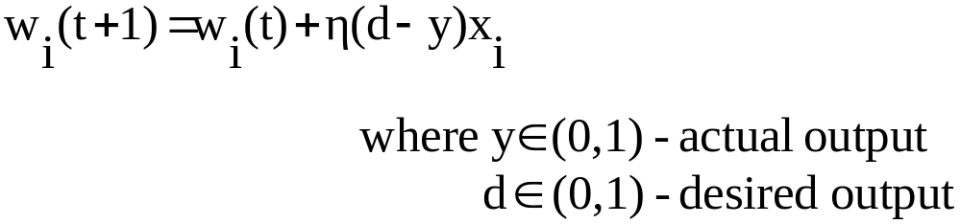
Learning Rules
  Perceptron’s learning rule
  Applicable only to single-layer feedforward neural networks.
  Difference in the outputs guides the process of updating the weights.
© 2007 Cios / Pedrycz / Swiniarski / Kurgan

Slide 41
NN Topologies
In most cases, neural network topology needs to be specified, to a smaller or larger extent, by the network designer.
The exceptions are ontogenic neural networks that generate their own topology on the fly
(as needed to solve a problem)
using criteria such as entropy to guide their growth.
© 2007 Cios / Pedrycz / Swiniarski / Kurgan

Slide 42
NN Topologies
NN topology can be looked upon as a directed graph, with neurons as nodes and the weighted connections between neurons as arcs.
In this view, NN topologies can be divided into two broad categories:
feedforward, with no loops and connections within the same layer
Example: Radial Basis Function
recurrent, with possible feedback loops
Example: Hopfield
© 2007 Cios / Pedrycz / Swiniarski / Kurgan

Slide 43
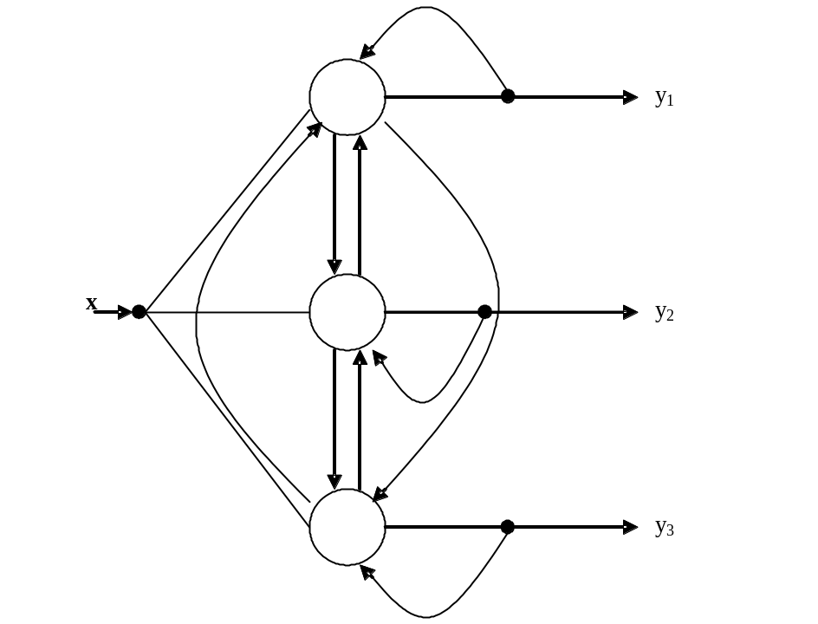
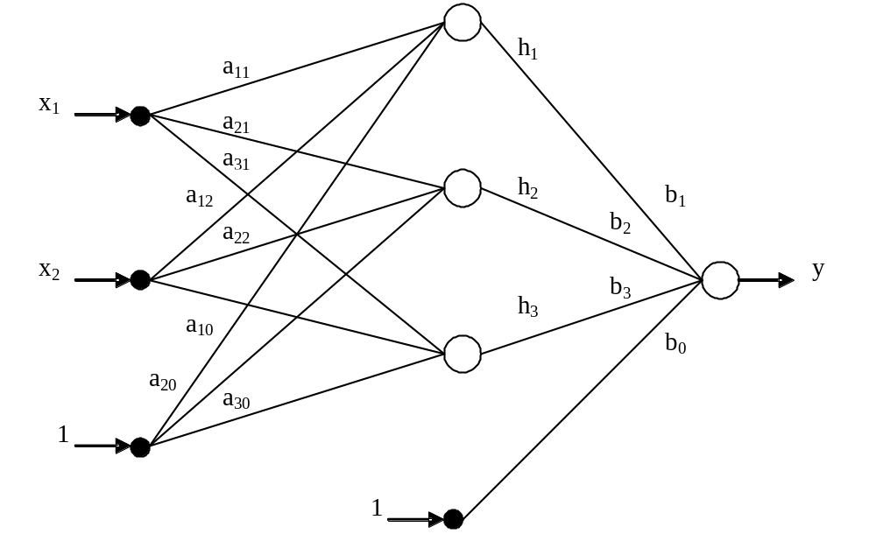


NN Topologies
© 2007 Cios / Pedrycz / Swiniarski / Kurgan

Slide 44
General Feedforward NN Algorithm
Given: Training input-output data pairs, stopping error criteria
  Select the neuron model
  Determine the network topology
  Randomly initialize the NN internal parameters (weights)
  Present training data pairs to the network, one by one, and compute the network outputs for each pair
  For each output that is not correct, adjust the internal parameters, using the chosen learning rule
  If all the output values are below the specified error value then stop; otherwise go to step 4
Result: Trained NN that represents the approximated mapping function y=f(x)
© 2007 Cios / Pedrycz / Swiniarski / Kurgan

Slide 45
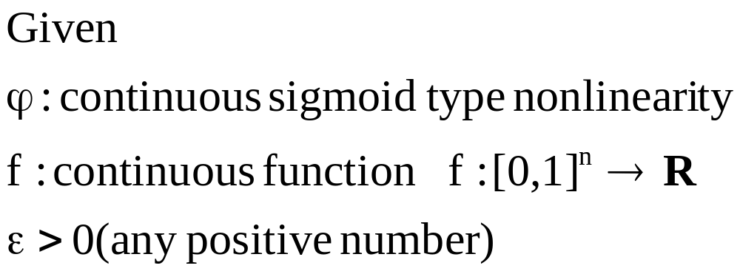
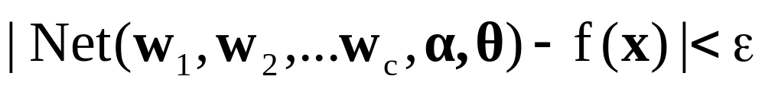
NN are Universal Approximators
© 2007 Cios / Pedrycz / Swiniarski / Kurgan

Slide 46
Radial Basis Functions
Characteristics:
The time required to train RBF networks is much shorter than for most other types of NNs.
Their topology is relatively simple to determine.
Unlike most of the supervised learning NN algorithms that find only a local optimum the RBFs can find a global optimum in some cases.
Like other NNs they are universal approximators.
© 2007 Cios / Pedrycz / Swiniarski / Kurgan

Slide 47
Radial Basis Functions
RBFs originated mainly in the field of regularization theory, developed as an approach to solving ill-posed problems
Ill-posed problems are those that do not fulfill the criteria of well-posed problems, namely,
a problem is well-posed when a solution to it exists, is unique, and depends on initial data.
© 2007 Cios / Pedrycz / Swiniarski / Kurgan

Slide 48
Radial Basis Functions
The mapping problem faced by supervised NN learning algorithms is ill-posed because it has an infinite number of solutions.
One approach to solving an ill-posed problem is to regularize it by introducing some constraints in order to restrict the search space.
In an approximation task of finding a mapping function between input-output pairs, regularization means smoothing of the approximation function.
© 2007 Cios / Pedrycz / Swiniarski / Kurgan

Slide 49
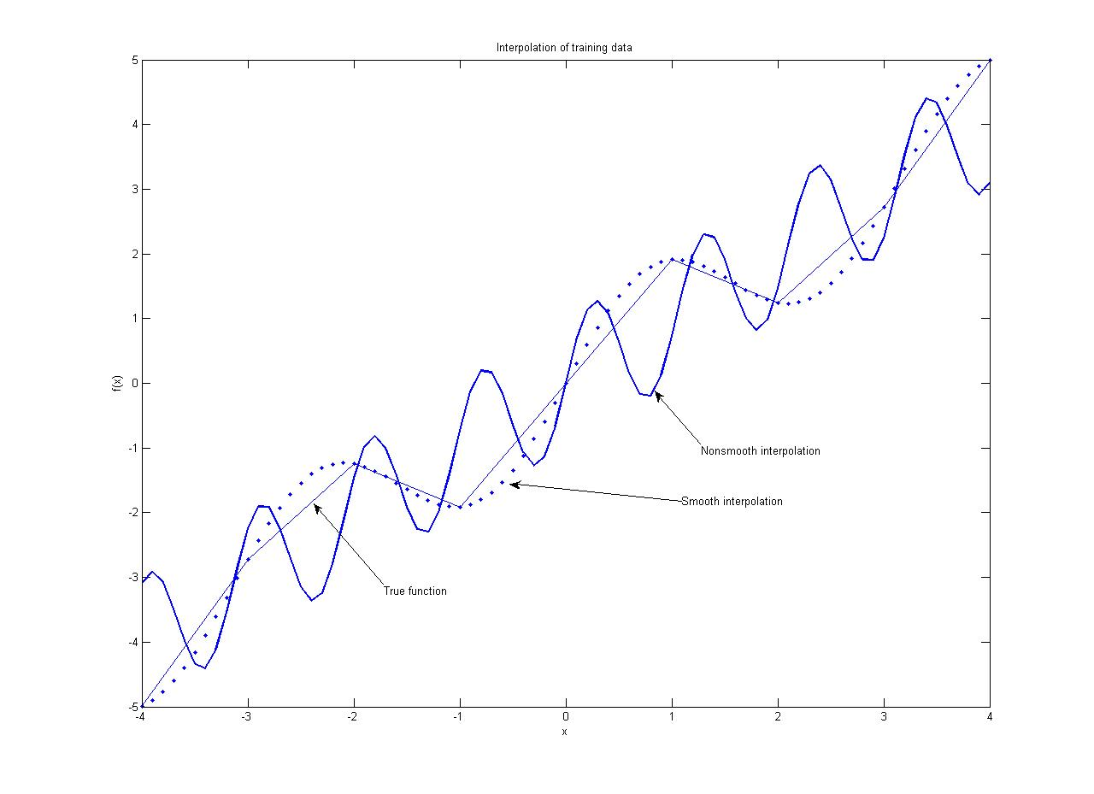
Radial Basis Functions
© 2007 Cios / Pedrycz / Swiniarski / Kurgan

Slide 50
Radial Basis Functions
Given a finite set of training pairs (x, y), we are interested in finding a mapping function, f, from an n-dimensional input space to an m-dimensional output space.
The function f does not have to pass through all the data points but needs to “best” approximate the “true” function f’: y = f’(x). In general, the approximation of the true function, given the training data points
f’ : y = f’(x ), is achieved by the function f:
y = f (x, w)
where w is a parameter called weight within the NN framework.
© 2007 Cios / Pedrycz / Swiniarski / Kurgan

Slide 51
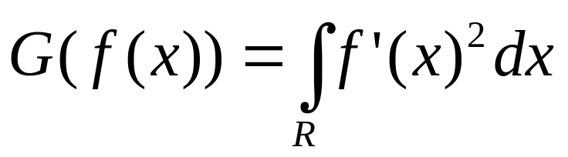
Radial Basis Functions
There are several ways to design an approximation function, but most involve calculating derivatives.
For example, we can calculate the first derivative of a function
(which amplifies oscillations and is thus indicative of smoothness)
and then square it and sum it up:
© 2007 Cios / Pedrycz / Swiniarski / Kurgan

Slide 52
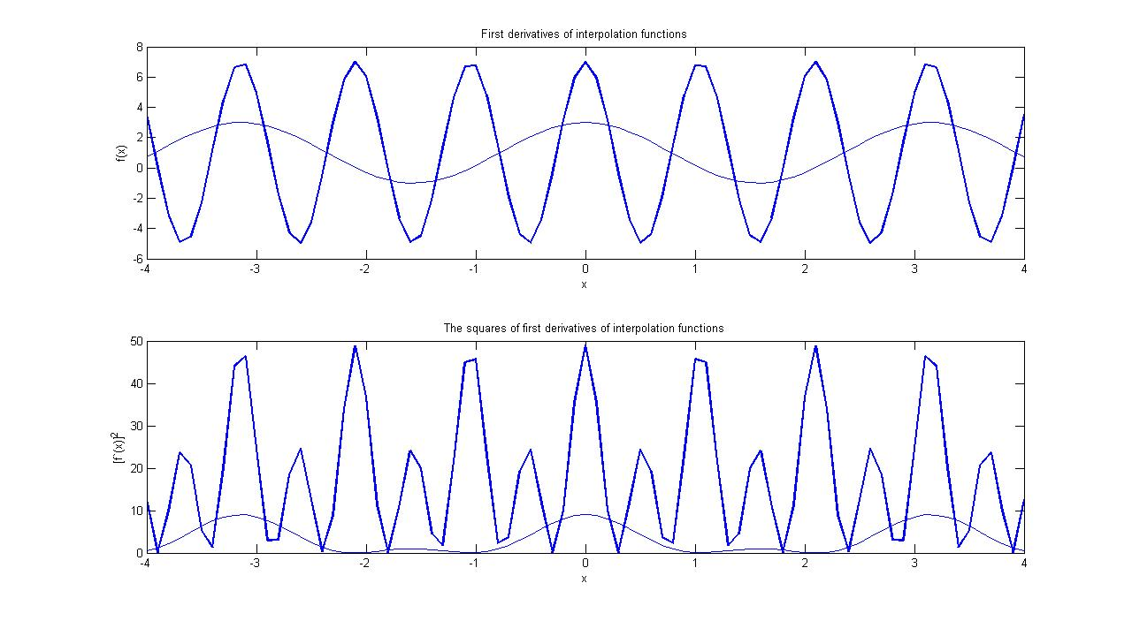
Radial Basis Functions
© 2007 Cios / Pedrycz / Swiniarski / Kurgan

Slide 53
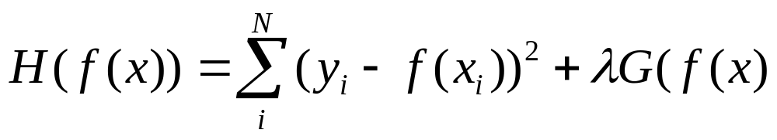
Radial Basis Functions
The general problem of approximating a function, for the given training data, can be formulated as one minimizing the following function:
where (xi, yi) is one of N training data pairs, f(xi) indicates the actual value, and yi indicates the desired value.
© 2007 Cios / Pedrycz / Swiniarski / Kurgan

Slide 54
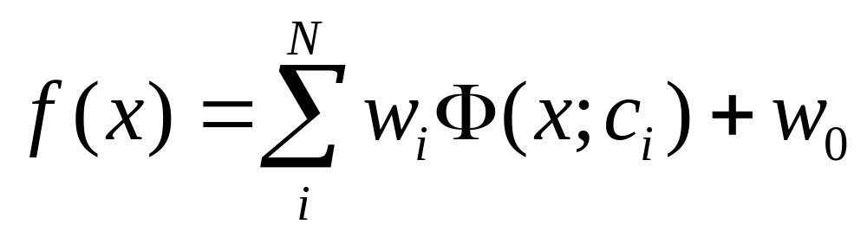
Radial Basis Functions
Having the minimizing function the task is to find the approximating function f(x) that minimizes it.
It takes the form:
where Ф(x; ci) is called a basis function.
© 2007 Cios / Pedrycz / Swiniarski / Kurgan

Slide 55
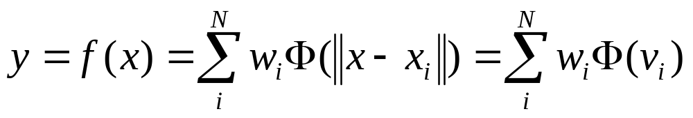
Radial Basis Functions
If the basis function is Gaussian with Euclidean metric calculating similarity/distance between x and ci, then the above equation defines a Radial Basis Function (RBF) that can be implemented as a NN.
Such a Gaussian basis function can be rewritten as:
where vi = ||xi – ci||, N is the number of neurons in the hidden layer centered at points ci, and the ||.|| is a metric used to calculate the distance between vectors xi and ci.
© 2007 Cios / Pedrycz / Swiniarski / Kurgan

Slide 56
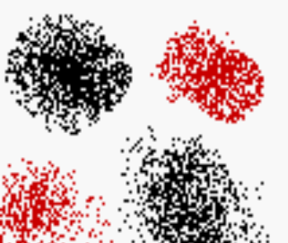
Receptive Fields: Data Patching
© 2007 Cios / Pedrycz / Swiniarski / Kurgan

Slide 57
Receptive Fields: Granularity
high
granularity
of receptive fields
low
granularity
of receptive fields
© 2007 Cios / Pedrycz / Swiniarski / Kurgan

Slide 58
Radial Basis Functions
When designing an RBF network, and before its training, several key parameters must be determined:
topology, i.e., determination of the number of hidden layer neurons (and their centers), and determination of the number of output neurons
selection of the similarity/distance measures
determination of the hidden-layer neuron radii
selection of basis functions
neuron models used in the hidden and output layers
© 2007 Cios / Pedrycz / Swiniarski / Kurgan

Slide 59
Radial Basis Functions
RBF network consists of just three layers
The number of “neurons” in the input-layer is defined by the dimensionality of the input vector, X. The input layer nodes are not neurons at all:
they are just feeding the input vector into all hidden-layer neurons.
The number of neurons in the output layer is determined by the number of categories represented in the training data.
© 2007 Cios / Pedrycz / Swiniarski / Kurgan

Slide 60
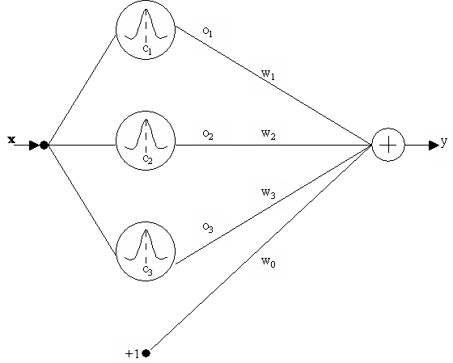
Radial Basis Functions
Simple, one-output RBF network.
© 2007 Cios / Pedrycz / Swiniarski / Kurgan

Slide 61
Determining the Number of Hidden Layer Neurons and their Centers
Neuron At Data Point (NADP) method:
    each of the training data points is used as a center, therefore the network always learns training data perfectly
    the method is fast and simple but it results in overfitting
© 2007 Cios / Pedrycz / Swiniarski / Kurgan

Slide 62
Determining the Number of Hidden Layer Neurons and their Centers
Spherical Clustering method:
  groups training data points into a pre-specified number of clusters
  generally gives good results but the number of clusters must be determined through trial and error or some other costly technique
© 2007 Cios / Pedrycz / Swiniarski / Kurgan

Slide 63
Determining the Number of Hidden Layer Neurons and their Centers
Elliptical Clustering method:
can be used to address the problem of Euclidean distance imposing hyperspherical clusters
selected center points determine distance weighting
distance vectors alter each cluster into an ellipsoid
© 2007 Cios / Pedrycz / Swiniarski / Kurgan

Slide 64
Determining the Number of Hidden Layer Neurons and their Centers
Elliptical Clustering method:
implies that all ellipses have the same size and point in the same direction
We can use Mahalanobis distance to avoid this problem, but calculating the covariance matrix is computationally expensive.
© 2007 Cios / Pedrycz / Swiniarski / Kurgan

Slide 65
Determining the Number of Hidden Layer Neurons and their Centers
Orthogonal Least Squares (OLS) method:
a variation of the NADP method but avoids problem of overfitting
uses subset of the given training data while the hidden layer neurons are set to a constant radius value
transforms training data vector into a set of
orthogonal basis vectors
Disadvantage:
the optimal subset must be determined by the user.
© 2007 Cios / Pedrycz / Swiniarski / Kurgan

Slide 66
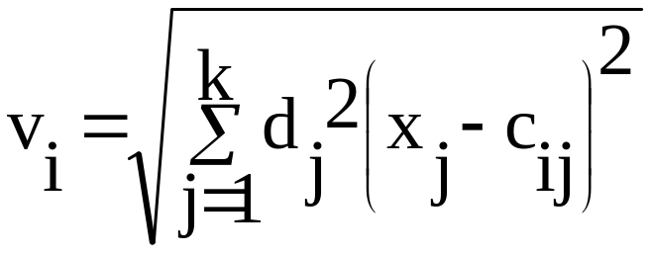
Distance Measures
Euclidean metric can be used to calculate the distance:
it implies that all the hidden layer neurons/clusters form hyperspheres
The weighted Euclidean distance measure may give more accurate results:
© 2007 Cios / Pedrycz / Swiniarski / Kurgan

Slide 67
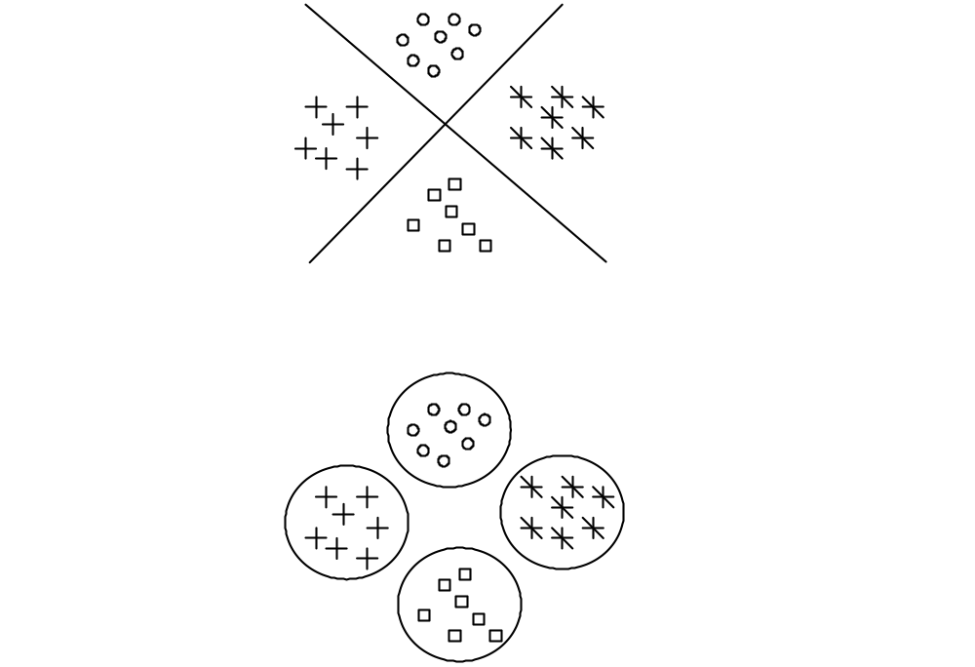
Classification outcomes performed by a hyperplane (top) and kernel (bottom) classifiers.
© 2007 Cios / Pedrycz / Swiniarski / Kurgan

Slide 68
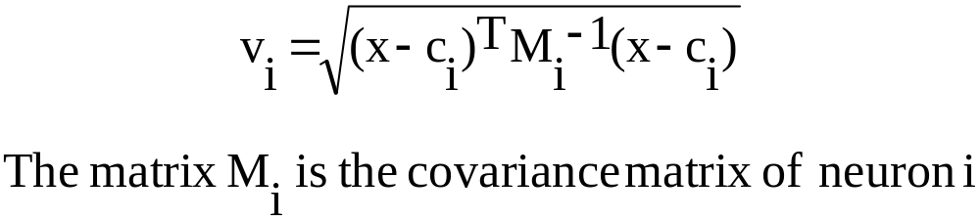
Distance Measures
Mahalanobis distance can also be used to calculate v:
© 2007 Cios / Pedrycz / Swiniarski / Kurgan

Slide 69
Neuron Radii
Constant radii:
    Set all values to a constant radii
    What to do if some clusters are larger than others?
    Finding the correct value requires using a trial and error method
© 2007 Cios / Pedrycz / Swiniarski / Kurgan

Slide 70

Neuron Radii
P-nearest neighbors:
  determines each neuron’s radius individually by calculating distance to P nearest center points
  P smallest distances are used to calculate the neuronal radius
© 2007 Cios / Pedrycz / Swiniarski / Kurgan

Slide 71

Illustration of the P-nearest neighbors method.
© 2007 Cios / Pedrycz / Swiniarski / Kurgan

Slide 72

Neuron Radii
    A variation of the P-nearest neighbor method:
      calculates the neuron radius by computing distance from one neuron center to all other
      selects smallest nonzero distance; multiplies it by scaling value; then calculates neuron radius:
© 2007 Cios / Pedrycz / Swiniarski / Kurgan

Slide 73
Neuron Radii
Class Interference algorithm is used to prevent RBF neurons from responding too strongly to input vectors from other classes
each neuron is assigned to a class determined by clustering
the radius for each neuron is set to a large initial value
set a threshold value “t” (see example)
© 2007 Cios / Pedrycz / Swiniarski / Kurgan

Slide 74


Illustration of the class interference method.
© 2007 Cios / Pedrycz / Swiniarski / Kurgan

Slide 75
Neuron Radii
Example of class interference algorithm.
Assume t = 0.2, γ = 0.95
Class 1 neuron, radius = 4.0
Basis function output for class 2 = 0.8;
since this is higher than t=0.2, we adjust radius:
Thus, the new radius for class 1 neuron= 4.0 * 0.95 = 3.8
© 2007 Cios / Pedrycz / Swiniarski / Kurgan

Slide 76

Basis Functions
Condition: they must be conditionally or strictly positive definite
Gaussian
Not effective in dealing with high-frequency components of a complicated mapping.
© 2007 Cios / Pedrycz / Swiniarski / Kurgan

Slide 77

Basis Functions
Thin plate spline function
Assumptions:
(v) = 0 when v = 0.0; therefore, output is negative if v is between v = 0.0 and 1.0, and output is positive if v > 1.0
Used in orthogonal least squares (OLS) algorithm
© 2007 Cios / Pedrycz / Swiniarski / Kurgan

Slide 78

Basis Functions
Quadratic basis function
    is not strongly dependent on radius of the neuron
Inverse quadratic
    a variation of the quadratic basis function
    As the value of v increase, it tends to converge to zero.
© 2007 Cios / Pedrycz / Swiniarski / Kurgan

Slide 79


Basis Functions
Cubic spline
    yields results comparable to other methods in accuracy
Linear spline
© 2007 Cios / Pedrycz / Swiniarski / Kurgan

Slide 80

Calculating Output Values
  After each hidden-layer neuron calculates its Φ(v) term, the output neuron calculates the dot product of two vectors of length N,
  Φ=[Φ(v1),Φ(v2),...,Φ(vN)] and w = [w1,w2,...,wN]
© 2007 Cios / Pedrycz / Swiniarski / Kurgan

Slide 81

Training the Output Weights
Finding the weight values between the hidden layer and the output layer is the only training required in the RBF network:
  Can be done using the minimization of the mean absolute error:
© 2007 Cios / Pedrycz / Swiniarski / Kurgan

Slide 82


Training for the Output Weights
Adjusted weight output:
Mean absolute error:
© 2007 Cios / Pedrycz / Swiniarski / Kurgan

Slide 83
Neuron Models
Two different neuron models are used in RBF networks:
one in the hidden layer and another in the output layer
They are determined by the type of the basis function used (most often Gaussian), and
the similarity/distance measure used to calculate the distance between the input vector and the hidden-layer center.
© 2007 Cios / Pedrycz / Swiniarski / Kurgan

Slide 84
Neuron Models
Two different neuron models are used in RBF networks:
The neuron model used in the output layer can be linear (i.e., it sums up the outputs of the hidden layer multiplied by the weights, to produce the output)
or
sigmoidal (i.e., produces output in the range 0-1).
The second type of an output layer neuron is most often used for classification problems, where, during training, the outputs are trained to be either 0 or 1 (in practice, 0.1 and 0.9, respectively, to shorten the training time).
© 2007 Cios / Pedrycz / Swiniarski / Kurgan

Slide 85
RBF Algorithm
Given: Training data pairs, stopping error criteria, sigmoidal neuron model, Gaussian basis function, Euclidean metric
  determine the network topology
  choose the neuron radii
  randomly initialize the weights between the hidden and output layer
  present the input vector, x, to all hidden layer neurons
  each hidden layer computes the distance between x and its center point
© 2007 Cios / Pedrycz / Swiniarski / Kurgan

Slide 86
RBF Algorithm
6. each hidden layer calculates its basis function output Φ(v)
7. each Φ(v) is multiplied by a weight value and is fed to the output neurons
8. The output neuron(s) sums all the values and outputs the sum as the answer
9. For each output that is not correct, adjust the weights by using a learning rule
10. if all the output values are below the specified error value, then stop. Otherwise go to step 8
11. repeat steps 3 through 9 for all remaining training data pairs
Result: Trained RBF network
© 2007 Cios / Pedrycz / Swiniarski / Kurgan

Slide 87

Radii and centers of three hidden-layer neurons, and two test points x1 and x2.
© 2007 Cios / Pedrycz / Swiniarski / Kurgan

Slide 88
RBF Example
The generated network has three neurons in the hidden layer, and one output neuron
The hidden layer neurons are centered at points
A(3, 3), B(5, 4), and C(6.5, 4)
and their respective radii are 2, 1, and 1
The weight values between the hidden and output layer were found to be
5.0167, -2.4998, and 10.0809
© 2007 Cios / Pedrycz / Swiniarski / Kurgan

Slide 89
RBF Example
Let us calculate the output for two new input test vectors x1 (4.5, 4) and x2 (8, 0.5)
In Step 5: Each neuron in the hidden layer calculates the distance from the input vector to its cluster center by using, the Euclidean distance. For the first test vector x1
d(A, x1) = ((4.5, 4), (3, 3)) = 1.8028
d(B, x1) = ((4.5, 4), (5, 4)) = 0.5000
d(C, x1) = ((4.5, 4), (6.5, 4)) = 2.0000
and for the x2
d(A, x2) = 5.5902 d(B, x2) = 4.6098 d(C, x2) = 3.8079
© 2007 Cios / Pedrycz / Swiniarski / Kurgan

Slide 90
RBF Example
In Step 6: Using the distances and their respective radii, the output of the hidden-layer neuron, using the Gaussian basis function, is calculated as follows. For the first vector
exp( -(1.8028/2)2 ) = 0.4449
exp( -(0.5000/1)2 ) = 0.7788
exp( -(2.0000/1)2 ) = 0.0183
and for the second
0.0004, 0.0000, 0.0000
© 2007 Cios / Pedrycz / Swiniarski / Kurgan

Slide 91
RBF Example
In Step 7: The outputs are multiplied by the weights, and the result is as follows:
for x1: 2.2319, -1.9468, 0.1844
and for x2: 0.0020, 0.0000, 0.0000
In Step 8: The output neuron sums these values to produce its output value:
for x1: 0.4696
and for x2: 0.0020
Are these outputs correct?
© 2007 Cios / Pedrycz / Swiniarski / Kurgan

Slide 92
Confidence Measures
  RBF networks, like other supervised NNs, give good results for unseen input data that are similar/close to any of the training data points but give poor results for unfamiliar (very different) input data.
  Confidence measures are used for flagging such unfamiliar data points
  They may increase overall accuracy of the network
  Confidence measures:
    - Parzen windows (see Chapter 11)
    - Certainty factors
© 2007 Cios / Pedrycz / Swiniarski / Kurgan

Slide 93

RBF network with reliability measures outputs
© 2007 Cios / Pedrycz / Swiniarski / Kurgan

Slide 94
Certainty Factors
CFs are calculated from the input vector's proximity to the hidden layer's neuron centers.
When the output Φ(v) of a hidden layer neuron is near 1.0, then this indicates that a point lies near the center of a cluster, which means that the new data point is very familiar/close to that particular neuron.
A value that is near 0.0 will lie far outside of a cluster, and thus the data are very unfamiliar to that particular neuron.
© 2007 Cios / Pedrycz / Swiniarski / Kurgan

Slide 95

CF algorithm
Given: RBF network with extra neuron calculating the certainty value
  For a given input vector calculate the outputs of the hidden layer nodes
  Sort them in descending order
  Set CF = 0.0
  For all outputs calculate:
Result: The final value of CF(t) is the generated certainty factor
© 2007 Cios / Pedrycz / Swiniarski / Kurgan

Slide 96

For our previous example the output using Certainty Factors
calculation for Vector1 is 0.88
and for Vector2 it is 0.0
© 2007 Cios / Pedrycz / Swiniarski / Kurgan

Slide 97
Comparison of RBFs and FF NN
FF can have several hidden layers; RBF only one
Computational neurons in hidden layers and output layer in FF are the same; in RBF they are very different
RBF hidden layer is nonlinear while its output is linear; in FF all are usually nonlinear
Hidden layer neurons in RBF calculate the distance;
neurons in FF calculate dot products
© 2007 Cios / Pedrycz / Swiniarski / Kurgan

Slide 98
RBFs in Knowledge Discovery
To overcome the problem of “black box” characteristic of NN, and to find a way to interpret weights and connections of a NN we can use:
Rule-based indirect interpretation of the RBF network
Fuzzy context-based RBF network
© 2007 Cios / Pedrycz / Swiniarski / Kurgan

Slide 99
Rule-Based Interpretation of RBF
RBF network is “equivalent” to a system of fuzzy production rules,
which means that the data described by the RBF
network corresponds to a set of fuzzy rules describing
the same data.
By using the correspondence the results can be interpreted and easily understood.
© 2007 Cios / Pedrycz / Swiniarski / Kurgan

Slide 100

Approximation of training data via basis functions Ф_{i} and fuzzy sets A_{i}.
© 2007 Cios / Pedrycz / Swiniarski / Kurgan

Slide 101

Rule-Based Interpretation of RBF
The form of the rule is:
© 2007 Cios / Pedrycz / Swiniarski / Kurgan

Slide 102
Rule-Based Interpretation of RBF
A generalized rule is:
Each such rule represents a partial mapping from x into y.
© 2007 Cios / Pedrycz / Swiniarski / Kurgan

Slide 103

Fuzzy Production Rules
Approximation of a function with fuzzy production rules.
© 2007 Cios / Pedrycz / Swiniarski / Kurgan

Slide 104
Fuzzy Production Rules
For RBF network the rule is:
Simple, one-output RBF network.
© 2007 Cios / Pedrycz / Swiniarski / Kurgan

Slide 105

Fuzzy production rules system.
© 2007 Cios / Pedrycz / Swiniarski / Kurgan

Slide 106
RBF Network in Knowledge Discovery
Fuzzy context-based RBF network
  Fuzzy contexts / data mining windows are used to select only pertinent records from a DB
  (Only records whose fields match a fuzzy context OUTPUT to a non-zero degree are retrieved)
  As a result the selected input data becomes clustered
© 2007 Cios / Pedrycz / Swiniarski / Kurgan

Slide 107

Fuzzy context and its data windowing effect on the original training set
© 2007 Cios / Pedrycz / Swiniarski / Kurgan

Slide 108
Fuzzy Context-Based RBF Network
For each context i we put pertinent data into ci clusters.
This means that for p contexts, we end up with c1, c2, … cp clusters.
The collection of these clusters will define the hidden layer for the RBF network.
The outputs of the neurons of this layer are then linearly combined by the output-layer neuron(s).
© 2007 Cios / Pedrycz / Swiniarski / Kurgan

Slide 109
Fuzzy Context-Based RBF Network
One advantage of using the fuzzy context is this shortening of training time, which can be substantial for large databases.
More importantly, the network can be directly interpreted as collection of IF…THEN…rules.
© 2007 Cios / Pedrycz / Swiniarski / Kurgan

Slide 110

Use of the Fuzzy Context RBF Network
Fuzzy context eliminates the need for training of the output layer weights since the outputs can be interpreted as “if-then” production rules
The computations involve rules of fuzzy arithmetic. To illustrate the fuzzy context RBF let us denote the output:
© 2007 Cios / Pedrycz / Swiniarski / Kurgan

Slide 111

Fuzzy sets of context.
© 2007 Cios / Pedrycz / Swiniarski / Kurgan

Slide 112
Example:
Given two fuzzy contexts Negative small and Positive small:
Assume that input x outputs for the first three hidden layer neurons, which correspond to the first fuzzy context:
0.0 0.05 0.60
and for the second fuzzy context the remaining two hidden layer outputs are:
0.35 0.00
By calculating the bounds using the above formula we obtain:
Lower bound: (0+0.05+0.60)(-4) + (0.35+0)(0) = -2.60
Modal Value: (0+0.05+0.60)(-1) + (0.35+0)(1) = -0.30
Upper bound: (0+0.05+0.60)(0) + (0.35+0)(4) = 1.40
© 2007 Cios / Pedrycz / Swiniarski / Kurgan

Slide 113
RBF as Collection of Fuzzy Rules
Fuzzy context RBF network can be interpreted as a collection of rules:
  the condition part of each rule is the hidden layer cluster prototype
  the conclusion of the rule is the associated fuzzy set of the context
General form:
IF input = hidden layer neuron THEN output = context A
where A is the corresponding context
© 2007 Cios / Pedrycz / Swiniarski / Kurgan

Slide 114
References
Broomhead, D.S., and Lowe, D. 1988. Multivariable functional interpolation and adaptive networks. Complex Systems, 2:321-355.
Cios, K.J., and Pedrycz ,W. 1997. Neuro-fuzzy systems. In: Handbook on Neural Computation. Oxford University Press, D1.1 - D1.8
Cios, K.J., Pedrycz, W., and Swiniarski R. 1998. Data Mining Methods for Knowledge Discovery. Kluwer
Hebb, D.O.1949. The Organization of Behavior. Wiley
Kecman, V., and Pfeiffer, B.M. 1994. Exploiting the structural equivalence of learning fuzzy systems and radial basis function neural networks. In: Proceedings of EUFIT’94, Aachen. 1:58-66
Kecman, V. 2001. Learning and Soft Computing. MIT Press
Lovelace J., and Cios K.J. 2007. A very simple spiking neuron model that allows for efficient modeling of complex systems. Neural Computation, 20(1):65-90
© 2007 Cios / Pedrycz / Swiniarski / Kurgan

Slide 115
References
McCulloch, W.S., and Pitts, W.H. 1943. A logical calculus of the ideas immanent in nervous activity. Bulletin of Mathematics and Biophysics, 5:115-133
Pedrycz, W. 1998. Conditional fuzzy clustering in the design of radial basis function neural networks. IEEE Transactions on Neural Networks, 9(4):601-612
Pedrycz, W., and Vasilakos, A.V. 1999. Linguistic models and linguistic modeling. IEEE Transactions on Systems, Man, and Cybernetics, Part C, 29(6):745-757
Poggio, F. 1994. Regularization theory, radial basis functions and networks. In: From Statistics to Neural Networks: Theory and Pattern Recognition Applications, NATO ASI Series, 136:83-104
Swiercz, W., Cios, K.J., Staley, K., Kurgan, L., Accurso, F., and Sagel S. 2006. New synaptic plasticity rule for networks of spiking neurons, IEEE Transactions on Neural Networks, 17(1):94-105
Wedding, D.K. II, and Cios, K.J. 1998. Certainty factors versus Parzen windows as reliability measures in RBF networks. Neurocomputing, 19(1-3): 151-165
© 2007 Cios / Pedrycz / Swiniarski / Kurgan

